Slide 1
Behavioural & Experimental Economics Strategic Interaction
Lunzheng Li
University of Cyprus

Slide 2
Course Outline
Choice under Certainty
Judgement under Risk & Uncertainty
Choices under Risk & Uncertainty
Intertemporal Choice
Strategic Interaction

Slide 3
Course Outline
Choice under Certainty
Judgement under Risk & Uncertainty
Choices under Risk & Uncertainty
Intertemporal Choice
Strategic Interaction
Analytical Game Theory
Behavioral Game Theory

Slide 4
Classroom Experiment

Slide 5
Strategic interaction
Up to now, we have looked at decision problems in which outcomes were determined solely by one’s own choices (and luck…).
The outcomes of many economic choices we make also depend on the choices of other economic agents. For example:
Bargaining and negotiations
Markets
Social & political interactions
Chess
The analysis of strategic interaction is the province of Game Theory.

Slide 6
Analytical Game Theory

Slide 7
Game Theory
A game is a decision problem in which the final outcome depends on the decisions of all players and the state of the world.
A game is defined, as a minimum, by:
the players,
their available choices
and the payoffs to each player for any combination of choices
A strategy is a complete plan of action that describes what a player will do under all possible circumstances.
The payoff matrix represents the payoffs associated with each possible combination of strategies.

Slide 8
Example: Prisoner’s Dilemma
Two prisoners are interrogated in separate rooms. They are told that
If they both admit their crime, they get 2 years of prison time.
If one admits and the other doesn’t, the one admitting goes free, and the other does 20 years.
If none of them admit it, they both do 10 years.
Each one needs to decide separately whether to:
Cooperate with the other: not admit anything!
Defect: confess the crime.

Slide 9
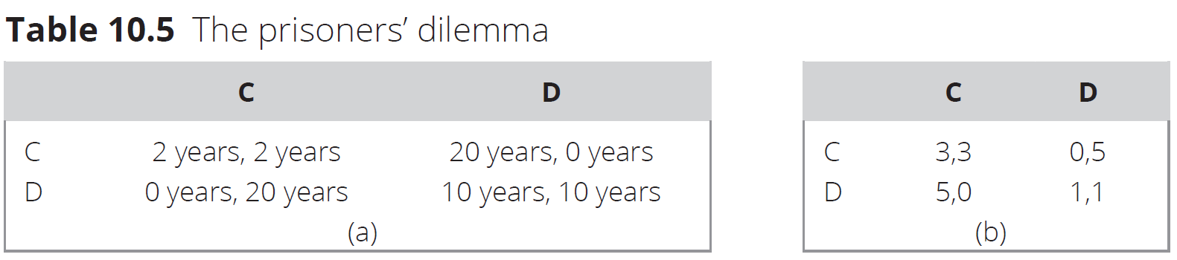
Example: Prisoner’s Dilemma

Slide 10
Example: Prisoner’s Dilemma

Slide 11
What should a player do in a game?
Unlike individual decision-making, the answer for strategic games is not always straightforward.
One’s best response depends on their beliefs about the other players’ strategy.

Slide 12
Dominant & dominated strategies
dominant strategy: a choice that is the best response to whatever action the other players choose.
dominated strategy: a choice that is never the best response to whatever action the other players choose.
Rationality implies that one should:
Always play a dominant strategy if one is available.
Never play a dominated strategy if one exists.

Slide 13
Prisoner's dilemma
Player 2
 | C | D
C | 3, 3 | 0, 5
D | 5, 0 | 1, 1
Player 1
For both players
Defect is a dominant strategy
Cooperate is a dominated strategy

Slide 14
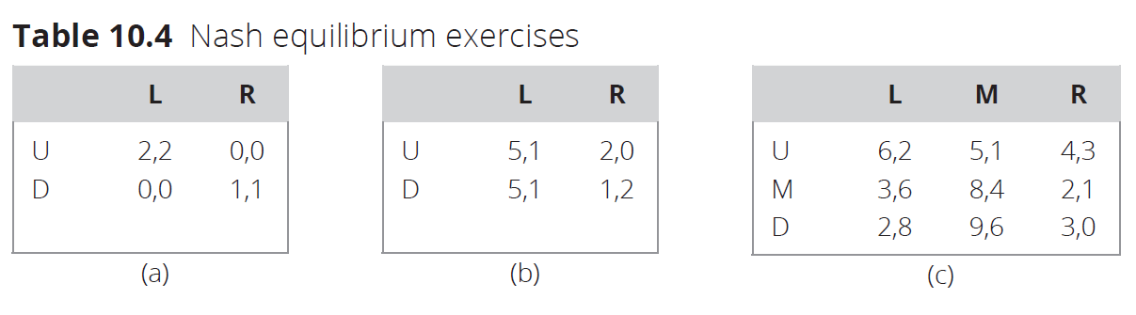
Examples

Slide 15
Player 2
 | L | R
U | 5, 1 | 2, 0
D | 5, 1 | 1, 2
Player 1
Is there for dominant strategy for Player 1?
If Player 2 chooses L, Player 1 is indifferent between U and D;
If Player 2 chooses R, Player 1 will choose U.
What about Player 2?

Slide 16
Player 2
 | L | R
U | 2, 2 | 0, 0
D | 0, 0 | 1, 1
Player 1
Is there for dominant strategy for Player 1?
If Player 2 chooses L, Player 1 chooses U;
If Player 2 chooses R, Player 1 chooses D.
no dominant strategy for both players

Slide 17

Nash equilibrium
What if there exists no Dominant strategy?
Nash equilibrium is a strategy profile such that each player is playing their best strategy given the decision of the other players.
If Dominant strategies exist, they always form part of a Nash equilibrium.

Slide 18
Player 2
 | L | R
U | 2, 2 | 0, 0
D | 0, 0 | 1, 1
Player 1
If Player 1 chooses U, what is Player 2’s best response?
If Player 1 chooses D, what is Player 2’s best response?
If Player 2 chooses L, what is Player 1’s best response?
If Player 2 chooses R, what is Player 1’s best response?

Slide 19
Prisoner's dilemma
Player 2
 | C | D
C | 3, 3 | 0, 5
D | 5, 0 | 1, 1
Player 1

Slide 20
Player 2
 | L | M | R
U | 6, 2 | 5, 1 | 4, 3
M | 3, 6 | 8, 4 | 2, 1
D | 2, 8 | 9, 6 | 3, 0
Player 1

Slide 21
Nash equilibrium in mixed strategies
Suppose you have to go to one of the two coffee shops, Lucy’s or Crestwood, and that your ex also has to.
You do not want to run into your ex, but your ex wants to run into you.
What kind of game would you be playing against each other?
You
 | Lucy’s | Crestwood
Lucy’s | 1, 0 | 0, 1
Crestwood | 0, 1 | 1, 0
You ex

Slide 22
You
q
1-q
 | Lucy’s | Crestwood
Lucy’s | 1, 0 | 0, 1
Crestwood | 0, 1 | 1, 0
Your ex
p
1-p
If p = 50%, your ex is indifferent between Lucy’s and Crestwood and can do no better than flipping a coin.
If q=50%, you are indifferent between Lucy’s and Crestwood and can do no better than flipping a coin.

Slide 23
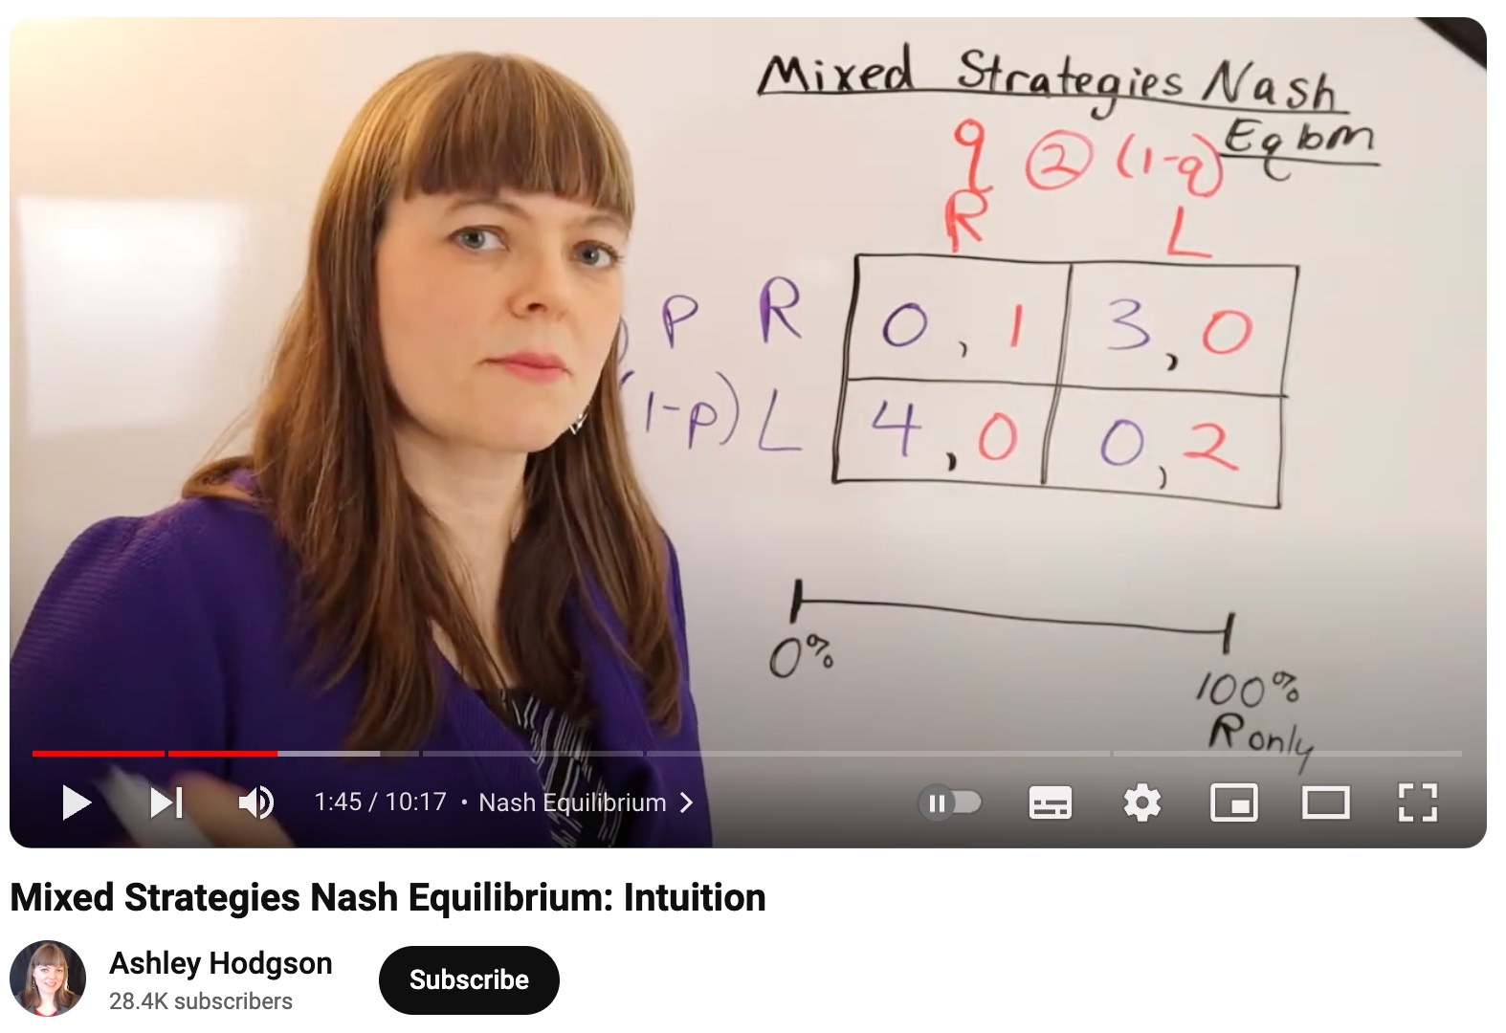
Nash equilibrium in mixed strategies
https://www.youtube.com/watch?v=-RiZiTz2hWA
Nash’s Theorem states that every finite game – that is, every game in which all players have a finite number of pure strategies – has a Nash equilibrium.

Slide 24
Equilibrium refinements
Player 2
 | L | R
U | 1, 1 | 0, 0
D | 0, 0 | 0, 0
Player 1
Is there something odd about the second equilibrium (D, R)?
U dominates D and L dominates R.
Thus, there seems to be no reason why rational individuals would ever play the second equilibrium (D, R).

Slide 25
Equilibrium refinements
Trembling-hand-perfect equilibrium A trembling- hand-perfect equilibrium is a Nash equilibrium that remains a best response for each player even when others have some minuscule probability of trembling, that is, accidentally playing an out-of- equilibrium strategy.
Player 2
(U, L) is a trembling-hand-perfect equilibrium: Even if there is a minuscule probability ε > 0 that Player 2 plays R, she still plays L with probability (1 − ε) and U remains a best response for Player 1.
By contrast, (D, R) is not trembling- hand perfect: If there is a minuscule probability ε > 0 that Player 2 plays L, no matter how small, U is a strictly preferred strategy for Player 1.
 | L | R
U | 1, 1 | 0, 0
D | 0, 0 | 0, 0
Player 1

Slide 26
Equilibrium refinements
Consider a game with two stages.
In the first stage, Player 1 plays U or D. If Player 1 plays D, both players get a payoff of 2. If Player 1 plays U, it is Player 2’s turn.
In the second stage, Player 2 plays L or R; if Player 2 plays L, Player 1 gets 5 and Player 2 gets 1. If Player 2 plays R, both get 0.
Player 2
 | L | R
U | 5, 1 | 0, 0
D | 2, 2 | 2, 2
Payoff Matrix?
Player 1
Nash equilibria?
Credible versus non-credible threats

Slide 27
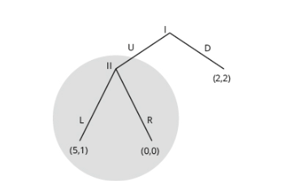
Equilibrium refinements
Normal-form game
Extensive-form game
 | L | R
U | 5, 1 | 0, 0
D | 2, 2 | 2, 2
Subgame-perfect equilibrium A subgame-perfect equilibrium is a strategy profile that constitutes a Nash equilibrium in each subgame.

Slide 28
Equilibrium refinements
Backward Induction
Start with the last subgame, that is, at the node where Player 2 moves. Since L would lead to a payoff of 1 and R would lead to a payoff of 0, L is the unique Nash equilibrium strategy.
So, in subgame-perfect equilibrium, Player 2 will play L. Given that Player 2 will play L, Player I has the choice between playing U for a payoff of 5, and playing D for a payoff of 2. Thus, Player I will play U.
In brief, there is only one subgame-perfect equilibrium in this game, and it is (U, L).

Slide 29
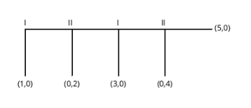
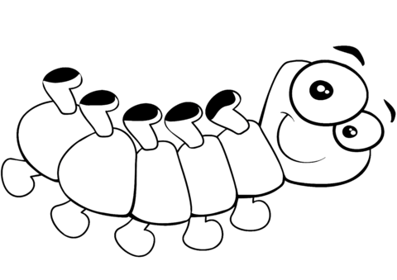
Exercise
At each stage, a player can Take, thereby ending the game, or Pass, thereby increasing the total payoff and allowing the other player to move.
Centipede game
(a) Use backward induction to find the unique subgame-perfect equilibrium.
(b) Would the outcome of the game differ if it had 1000 stages instead of four?

Slide 30
A good normative theory?
When dominant/dominated strategies exist, analytical Game Theory gives clear normative prescriptions.
Nash equilibrium always exists, but should one always play a Nash equilibrium strategy?
There might be multiple equilibria
It requires common knowledge of rationality
Is the game considered the real game played? E.g. repeated play, social preferences…

Slide 31
A good descriptive theory?
There are many cases where game theoretical analysis gives predictions that allow us to understand economic agents’ behavior.
It is an important tool for economics and other social sciences.
But there also cases where individuals do not behave in the way predicted by classic game theory.
Behavioral Game Theory extends the toolset we have in two directions:
Social-preferences: same solution concepts, but allows individuals’ preferences to be affected by social interaction.
Limited strategic thinking: new solution concepts that allow individuals to be less than perfectly rational.

